Slide 1
Wine Classification – Unsupervised Learning

Slide 2
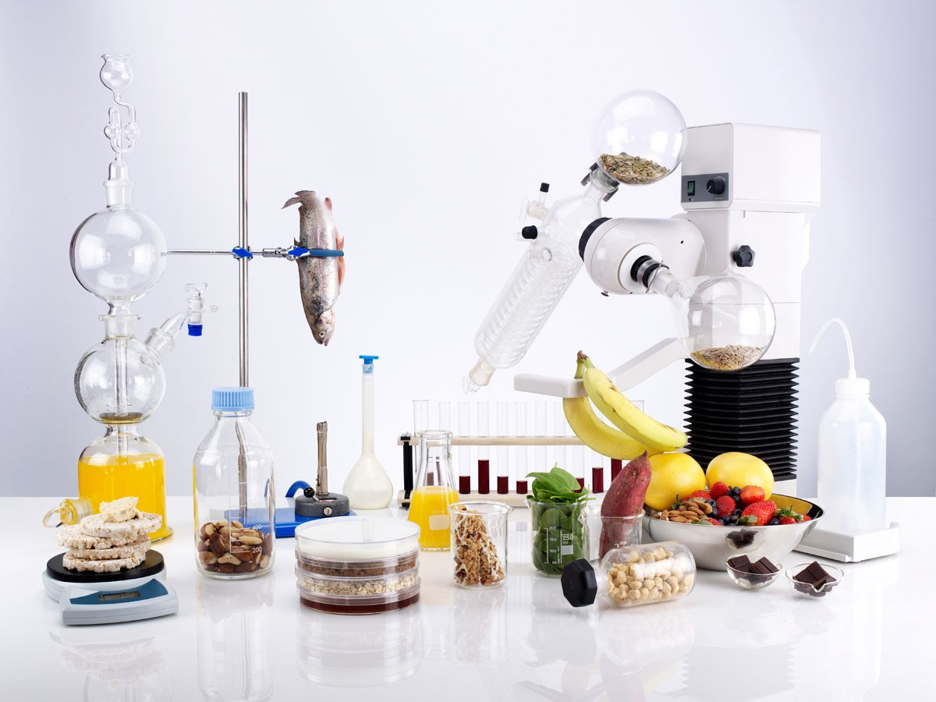
Food Science
Food Science is a multidisciplinary subject that combines biology, chemistry, and nutrition to better understand food processes and improve food products.
Using data science techniques to approach food science problems is becoming more common.

Slide 3

Food Science
Some key areas of development:
Preventing disease in crops
Reducing food waste
Climate change resilience
Commercial value – personalization

Slide 4

The Data
Why wine data?
Wine data – 13 features derived from the chemical analyses of 178 wines
Wines belong to three different cultivars
Goal: create a model in which a cultivar can be determined through the analyses of the wine.
Features include:
Alcohol
Malic acid
Ash
Alkalinity
Magnesium
Total Phenols
Flavanoids
Nonflavanoid phenols
Proanthocyanins
Color intensity
Hue
0D280/0D315
Proline

Slide 5
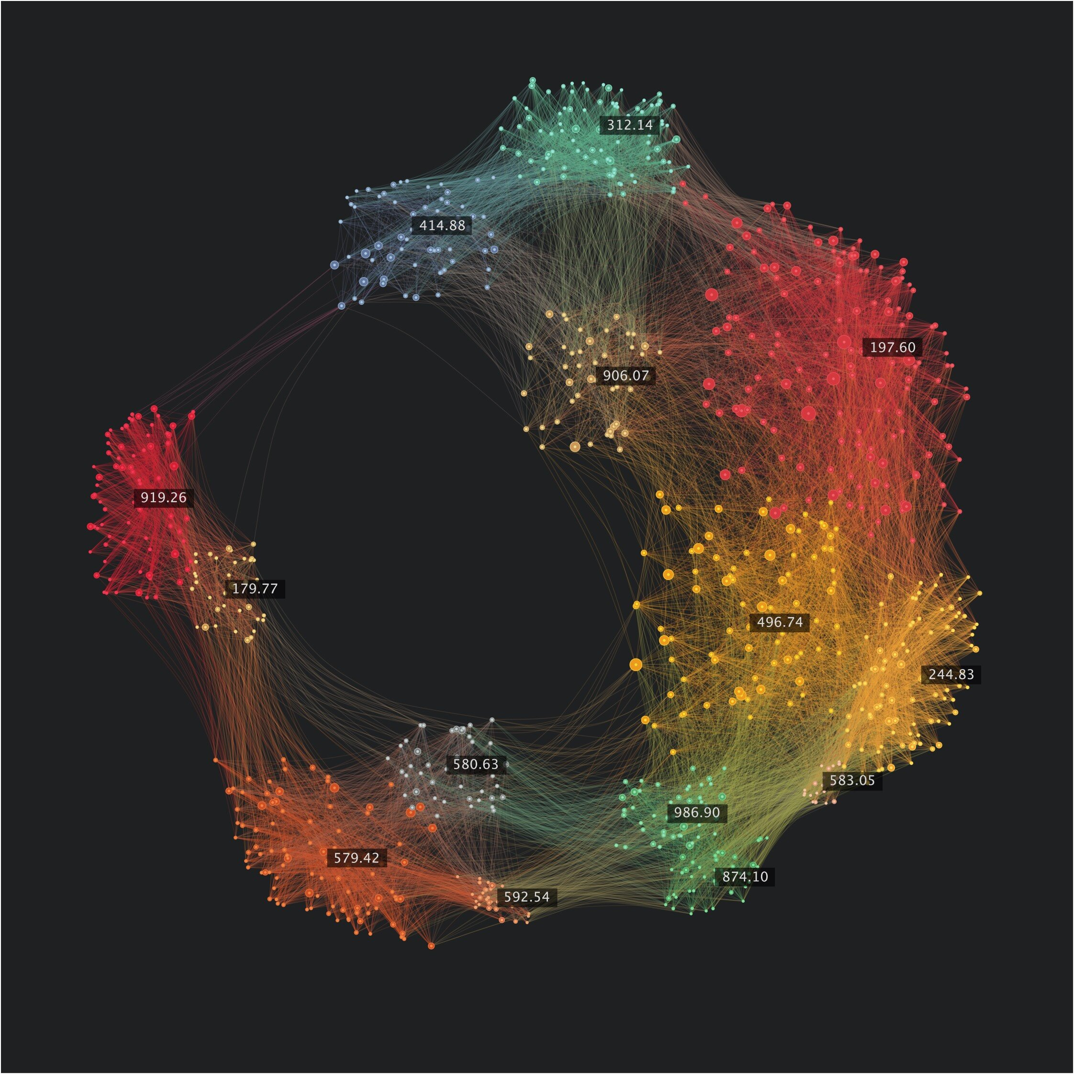
The Approach: Clustering
Hierarchical and K-Means clustering
Supervised approaches?

Slide 6

The Process
The general process to develop the final model is as follows:
Data Read-In and Cleaning
Exploratory Data Analysis
Data Preprocessing
Feature Selection and Importance
Model Training and Evaluation
Supervised Methods Training
Model Comparison

Slide 7
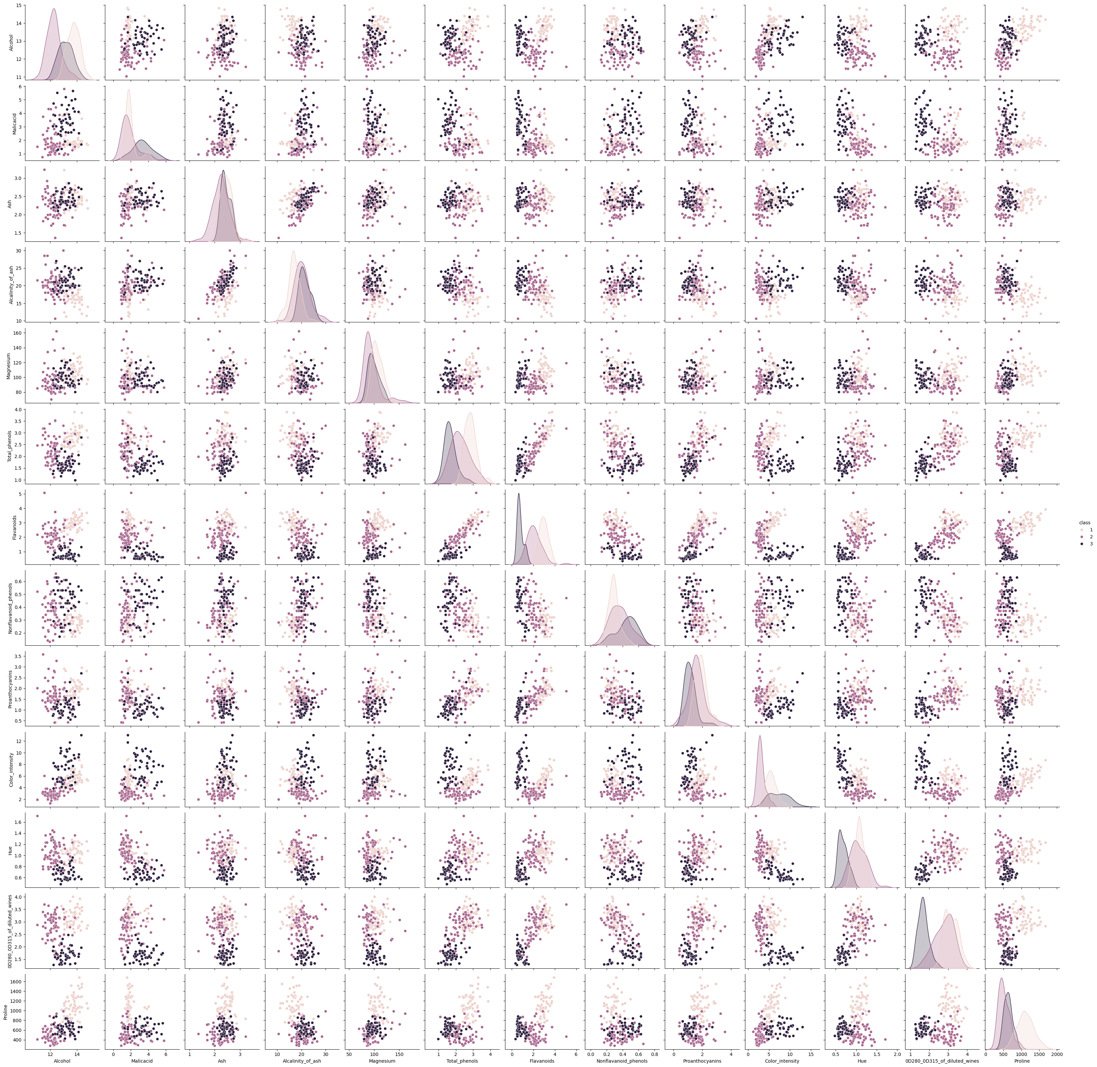
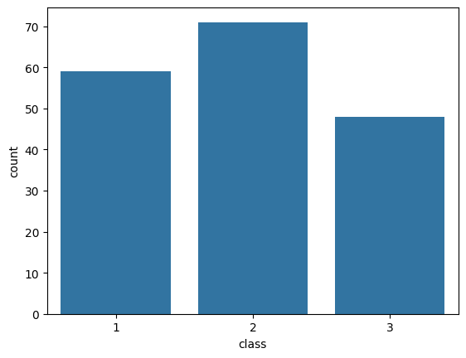
Exploratory Data Analysis

Slide 8
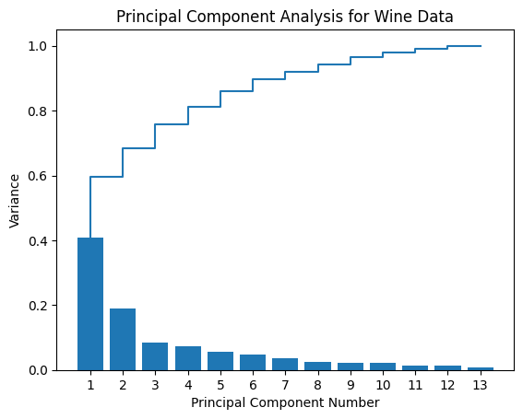
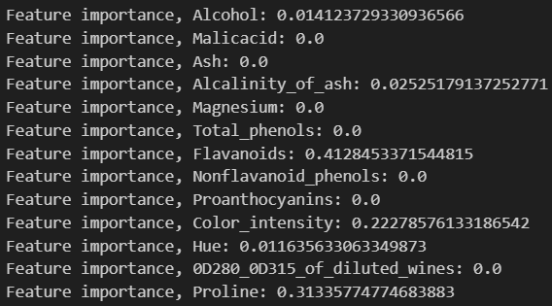
Data Preprocessing, Feature Selection, and Feature Importance
Over half of the variance of the dataset is contained within the first two components, with the first six containing nearly 90% of the variance.
The general process for feature selection is as follows:
Split the data into X and y
Use tree-based estimators
Run feature importance
The data was split into train and test data using an 80/20 split.

Slide 9
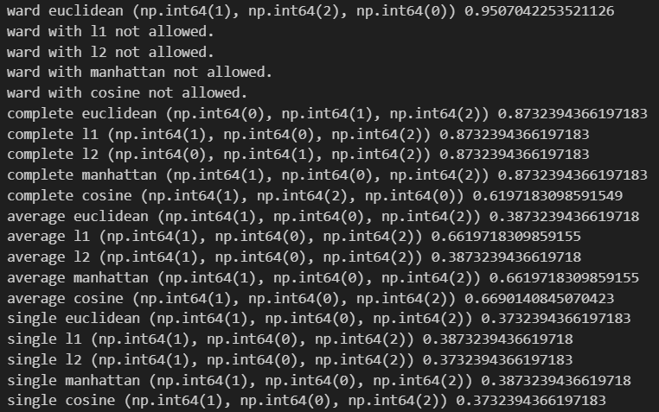
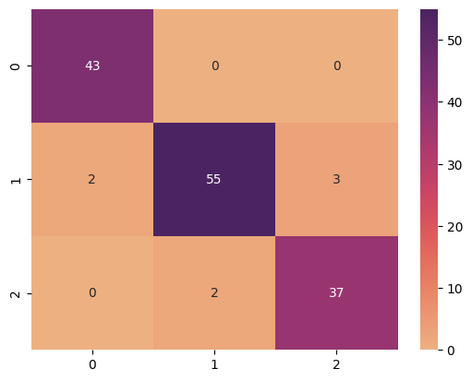
Results: Hierarchical Clustering Model Parameter Selection and Training
Training accuracy: 0.951

Slide 10
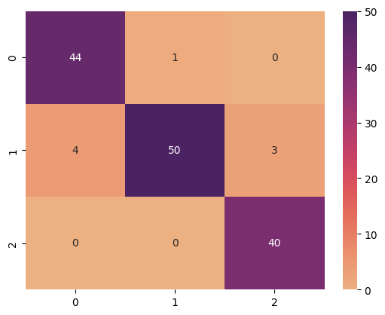
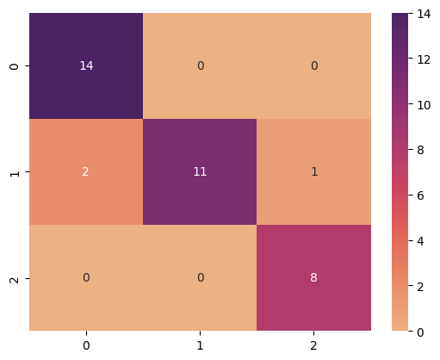
Results: K-Means Clustering Model
Training accuracy: 0.943
Testing accuracy: 0.917
Compared to the hierarchical clustering model, accuracy is slightly lower.

Slide 11
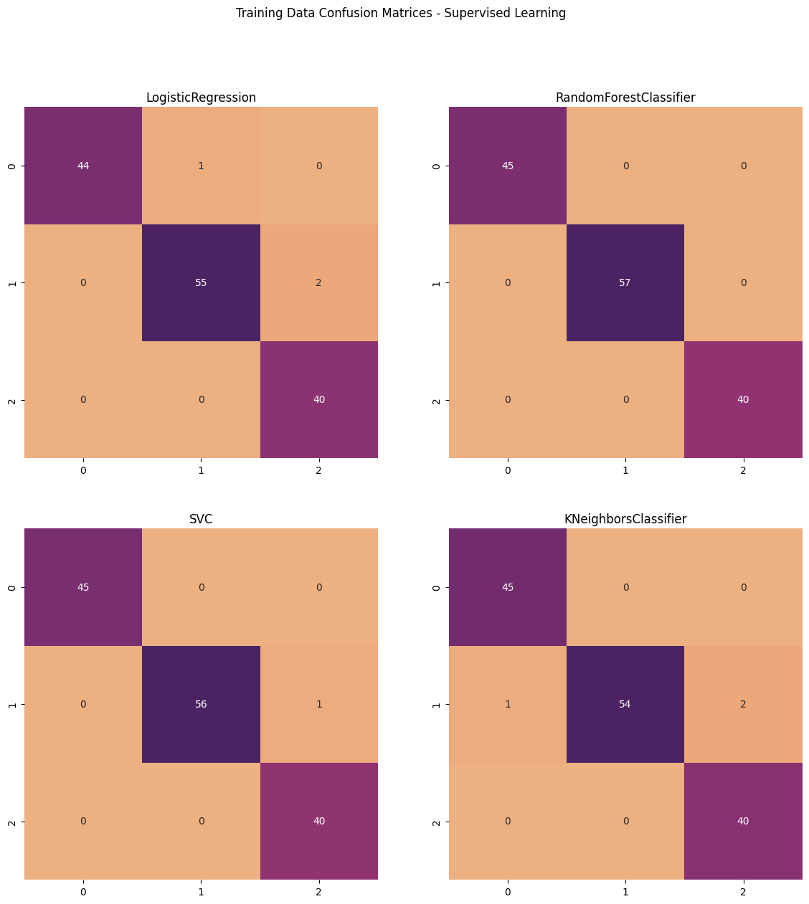
Supervised Methods Training
Methods used:
Logistic Regression
Random Forest
Support Vector Classification
K-Nearest Neighbours
Training Accuracy Scores:
Logistic Regression: 0.979
Random Forest: 1.0
Support Vector Classification: 0.992
K-Nearest Neighbours: 0.979

Slide 12
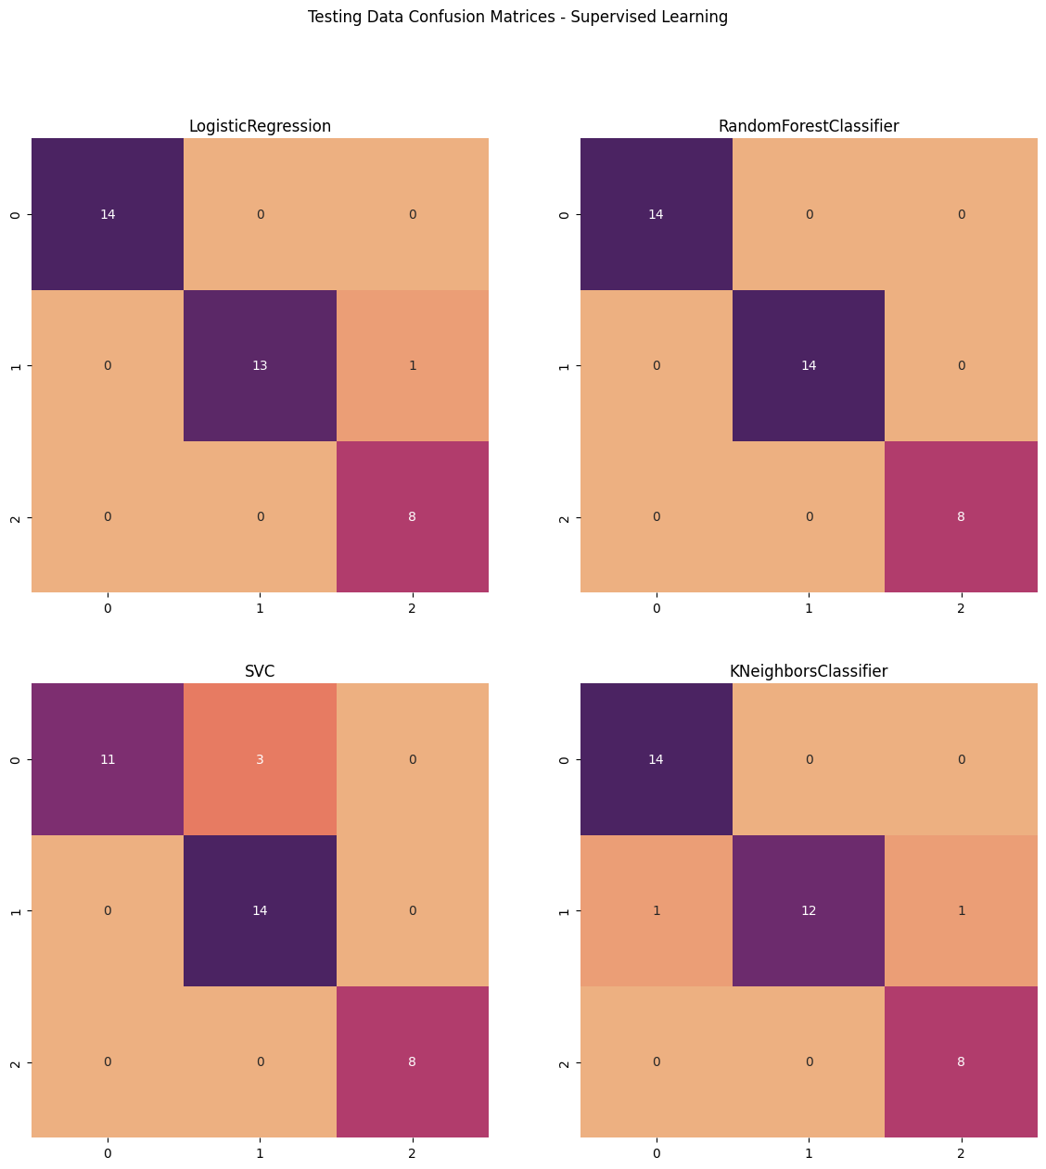
Supervised Methods Testing
Testing Accuracy Scores:
Logistic Regression: 0.972
Random Forest: 1.0
Support Vector Classification: 0.917
K-Nearest Neighbours: 0.944

Slide 13
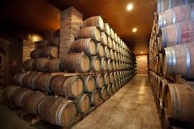
Conclusion
Model performance was relatively high across all models.
While the intent of this analysis was to investigate unsupervised clustering methods, supervised methods saw success as well.
Future directions may improve accuracy across models and provide a more comprehensive approach to classification.

